Slide 1
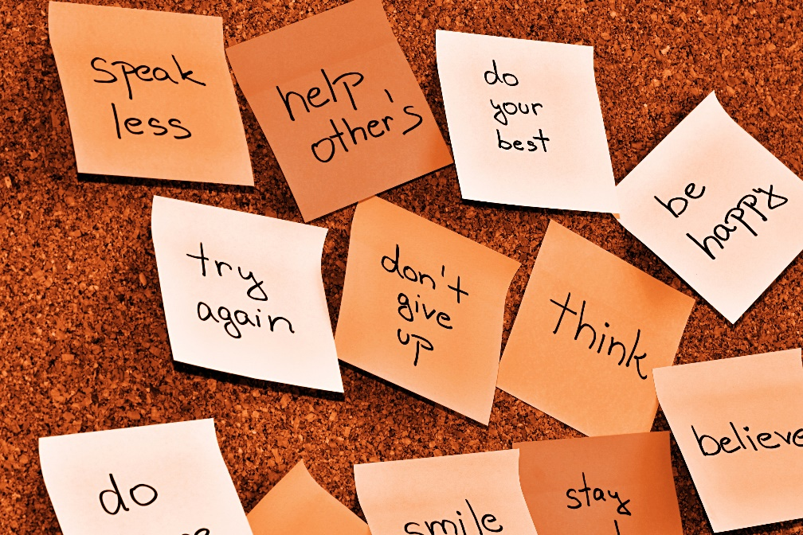
Exercise 1: HiLo and CorkBoard

Slide 2
Exercise 1 Part A: HiLo
Write the guessing game in Python. The computer thinks of a number between 1 and 100 and the user makes guesses. After every guess the computer says “Higher” or “Lower”.
Give nice instructions at the start of the game
Give friendly feedback to the player during the game – be creative
Optional: tell the player how many guesses it took
Notes:
Not too ruff
Won’t hurt my felines.
Getters and Setters (not the Irish kind)
No need to Pause between them

Slide 3
Exercise 1 Part B: CorkBoard
Create class Message with a String “sender”, a String “message”, and a Date “date”.
Create the CorkBoard object:
“postMessage” – add a message
“getMessages” – return the list of accumulated messages
“clear” – erase all messages
Optional: “getMessagesFrom” – takes a list of strings (senders) and returns all messages from those senders
Write a function to add a number of sample messages to the board
Write Python code to test the cork board

